Slide 1

The ratio between percentage change in demand and percentage change in price is called price elasticity of demand.

Slide 2

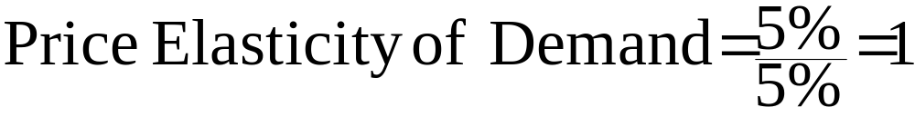
If percentage change in quantity of demand is equal to percentage change in price, demand is unitarily elastic.
Suppose a 5% change in price results in a 5% change in quantity of demand.

Slide 3










Figure- 4.1

Slide 4

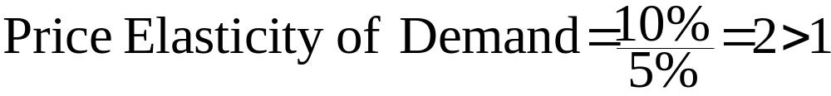
If percentage change in quantity demanded is larger than percentage change in price, demand would be elastic. Suppose a 5% change in price results in a 10% change in quantity of demand.

Slide 5









Figure- 4.2

Slide 6

Perfectly Elastic Demand: If quantity of demand changes without any change in price, demand is perfectly elastic. In this special case demand curve would be horizontal which is a distinguishing feature of perfectly competitive market structure where price remains fixed but the consumers can buy any amount they desire. Elasticity coefficient (e) turns out to be infinity , because something divided by zero is infinity

Slide 7






.
Figure- 4.3

Slide 8

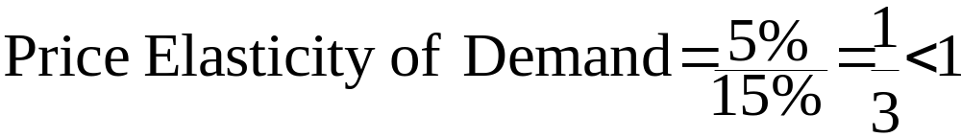
If percentage change in quantity of demand is smaller than percentage change in price, demand is inelastic.
Suppose a 15% change in price results in a 5% change in quantity of demand.

Slide 9



Figure- 4.4

Slide 10

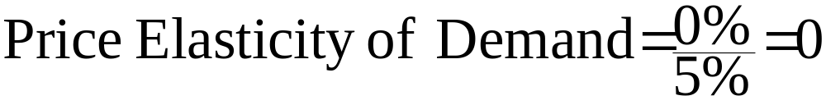
When demand remains completely unresponsive to price, i.e, no change in demand occurs following changes in price, demand is said to be perfectly inelastic. Say, there is a 5% change in price, but demand is unchanged

Slide 11



Figure- 4.5

Slide 12

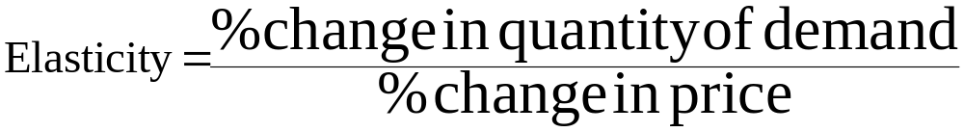
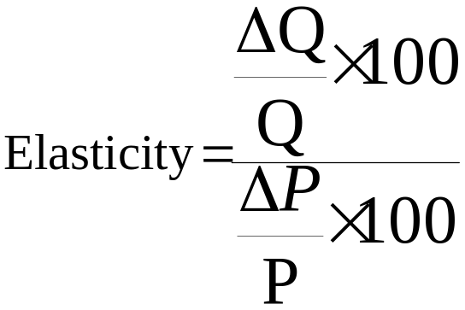
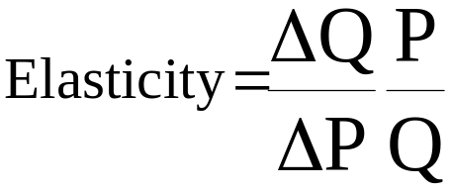
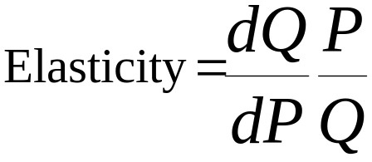
.

Slide 13




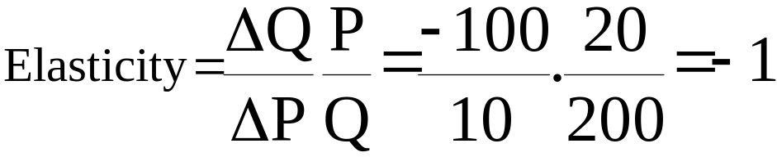
Assume a demand function
Suppose price changes from 20 to 30. Compute elasticity.
Solution: When P = 20, Q = 200
when P = 30, Q = 100

Slide 14

Again assume that price changes from 20 to 25. what is elasticity now?
Comment on the results.

Slide 15

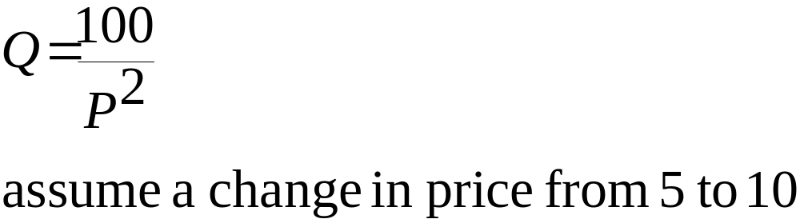
.

Slide 16

The ratio between percentage change in quantity of demand for one good and percentage change in price of another good is termed as cross price elasticity of demand.

Slide 17
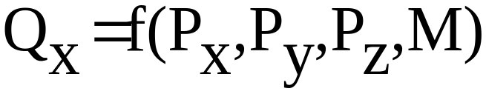
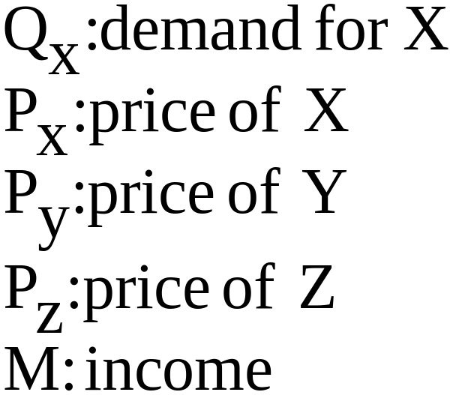
For illustration, assume the demand function:
Demand for X depends on its own price, price of Y, Z and income (M). Two cross price elasticity's can be defined as below.

Slide 18

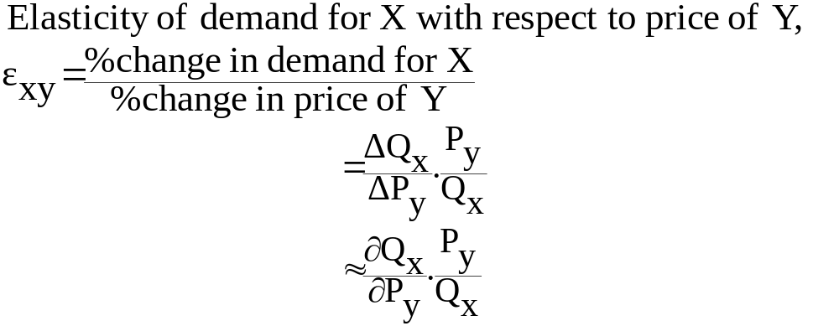
.

Slide 19

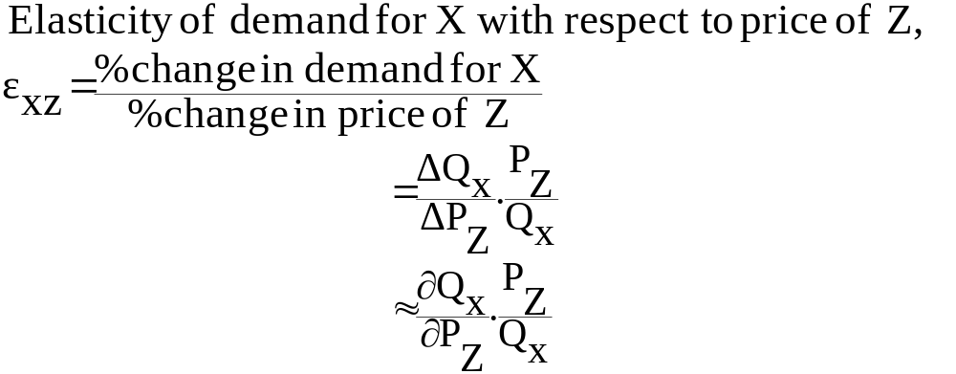
.

Slide 20

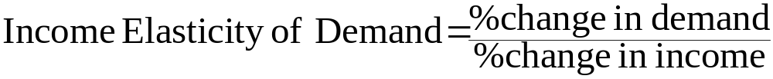
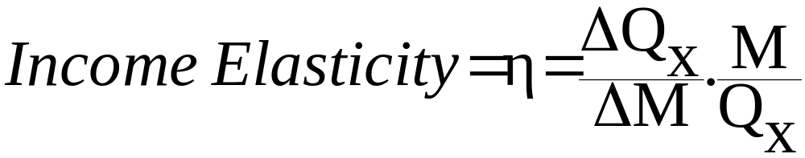
Income Elasticity is defined as the ratio between percentage change in quantity of demand and percentage change in income.

Slide 21

If cross elasticity is positive, goods are substitutes
If cross elasticity is negative, goods are complementary
If income elasticity is positive, good is normal
If income elasticity is negative, good is inferior.

Slide 22



Figure- 4.7

Slide 23









Figure- 4.8

Slide 24

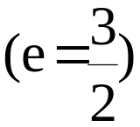
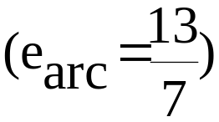










Figure- 4.9

